Slide 1

Methodist College of Engineering & Technology
Group Number: 05
Guide Name: Ms. Unnati K
Domain/Context: Machine Learning
Project Team:
S. No. | Roll no. | Student Name | Role in Team
1 | 160717733008 | T SAI CHARAN | Team Leader
2 | 160717733004 | N GAGAN KUMAR | Team Member
3 | 160717733032 | A SREEKAR | Team Member
Signatures Guide Project Co-Ordinator
(Team Members)

Slide 2
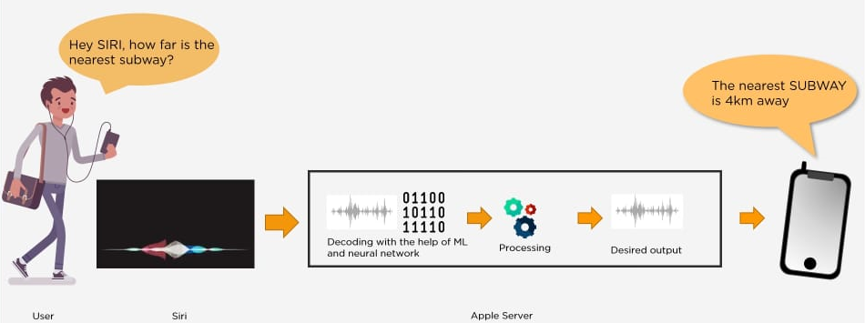
Definition:
Machine learning is an application of artificial intelligence (AI) that provides systems the ability to automatically learn and improve from experience without being explicitly programmed. Machine learning focuses on the development of computer programs that can access data and use it to learn for themselves on the basis of past experience.

Slide 3
History:
Machine Learning is a sub-set of artificial intelligence where computer algorithms are used to autonomously learn from data and information. In machine learning computers don’t have to be explicitly programmed but can change and improve their algorithms by themselves.
1950 — Alan Turing creates the “Turing Test” to determine if a computer has real intelligence. To pass the test, a computer must be able to fool a human into believing it is also human.
1952 — Arthur Samuel wrote the first computer learning program. The program was the game of checkers, and the IBM computer improved at the game the more it played, studying which moves made up winning strategies and incorporating those moves into its program.

Slide 4
1957 — Frank Rosenblatt designed the first neural network for computers (the perceptron), which simulate the thought processes of the human brain.
1979 — Students at Stanford University invent the “Stanford Cart” which can navigate obstacles in a room on its own.
1981 — Gerald Dejong introduces the concept of Explanation Based Learning (EBL), in which a computer analyses training data and creates a general rule it can follow by discarding unimportant data.
1990s — Work on machine learning shifts from a knowledge-driven approach to a data-driven approach. Scientists begin creating programs for computers to analyze large amounts of data and draw conclusions — or “learn” — from the results.

Slide 5
1997 — IBM’s Deep Blue beats the world champion at chess.
2006 — Geoffrey Hinton coins the term “deep learning” to explain new algorithms that let computers “see” and distinguish objects and text in images and videos
2010 — The MICROSOFT Kinect can track 20 human features at a rate of 30 times per second, allowing people to interact with the computer via movements and gestures.
2014 – FACEBOOK develops Deep Face, a software algorithm that is able to recognize or verify individuals on photos to the same level as humans can.

Slide 6
2015 – Amazon launched its own machine learning platform.
2015 – Over 3,000 AI and Robotics researchers, endorsed by Stephen Hawking, Elon Musk and Steve Wozniak (among many others), sign an open letter warning of the danger of autonomous weapons which select and engage targets without human intervention.
2016 – Google’s artificial intelligence algorithm beats a professional player at the Chinese board game Go, which is considered the world’s most complex board game and is many times harder than chess. The AlphaGo algorithm developed by Google DeepMind managed to win five games out of five in the Go competition.

Slide 7
Types of machine learning:
Machine learning can be classified into 3 types of algorithms.
Supervised Learning
Unsupervised Learning
Reinforcement Learning

Slide 8
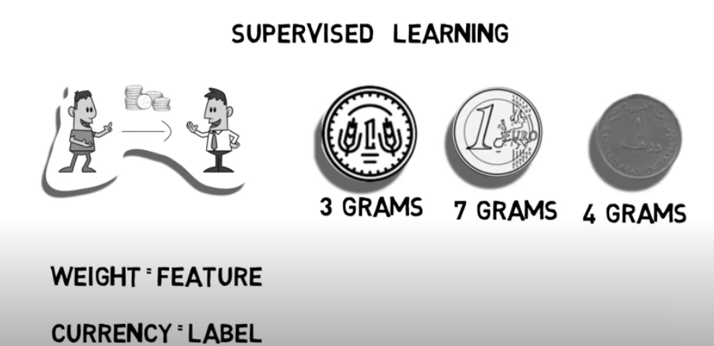
In Supervised learning, an AI system is presented with data which is labeled, which means that each data tagged with the correct label.

Slide 9
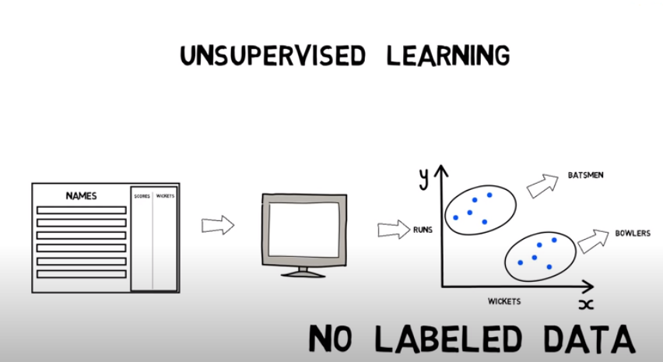
In unsupervised learning, an AI system is presented with unlabeled, uncategorized data and the system’s algorithms act on the data without prior training the output is dependent upon the coded algorithms.

Slide 10
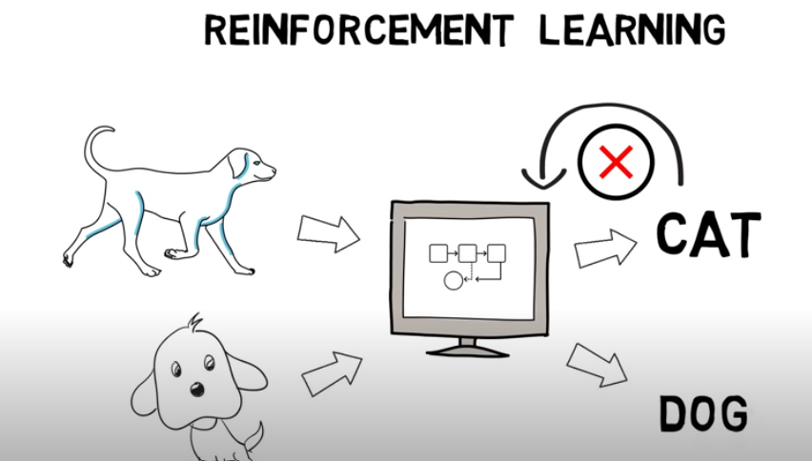
A reinforcement learning algorithm, or agent, learns by interacting with its environment. The agent receives rewards or feedback by performing correctly and penalties for performing incorrectly.

Slide 11
Limitations:
Lack of Data
Lack of access to the Data
Privacy problems
Lack of resources
Time – Training requires a lot of computational time.

Slide 12



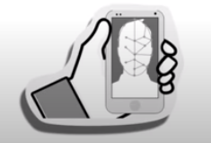
Applications:
Online Fraud Detection
Recommendation system
Email Spam and Malware Filtering
Face Recognition

Slide 13
Few popular frameworks:
Scikit-Learn
Tensorflow
PyTorch
Keras
Pandas
Popular Languages uses machine learning:
Python
R
Julia
Java

Slide 14
Why Machine Learning?
Machine learning is one modern innovation that has helped man enhance many industrial and professional processes but also advances everyday living.
Currently, machine learning has been used in multiple fields and industries. For example, medical diagnosis, image processing, prediction, classification, learning association, regression etc.
Machine learning applications provide results on the basis of past experience.

Slide 15
Applications:
Image Recognition
Speech Recognition
Medical Diagnosis
Learning Associations
Classification
Prediction
Extraction
Regression
Handwriting Recognition
Recommendation System

Slide 16

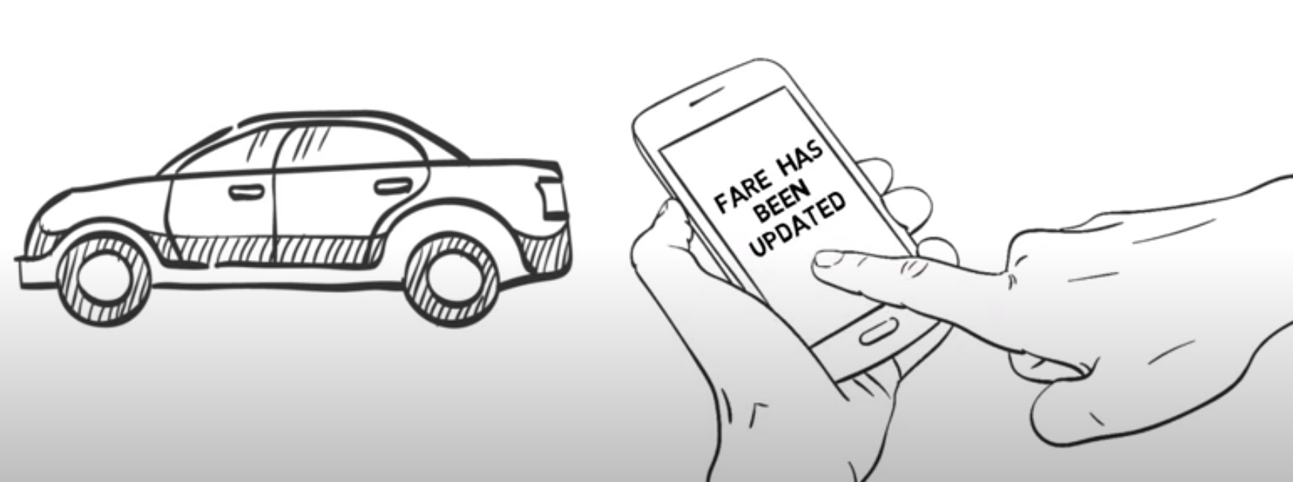
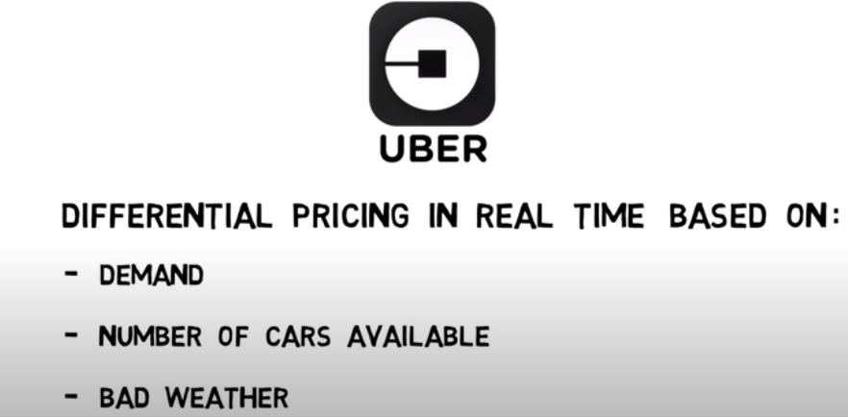
Regular life example we mostly seen: UBER

Slide 17
Thank you

